Slide 1


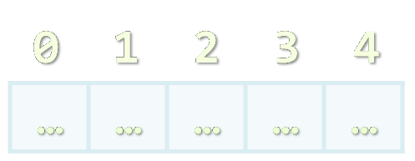


Arrays, Lists, Stacks, Queues
Processing Sequences of Elements
Advanced C#
SoftUni Team
Technical Trainers
Software University
http://softuni.bg

Slide 2
Summary
Lists are resizable arrays
Only for ArrayLists – the array implementation of the list interface
On the other hand there are LinkedLists which do not have an array under them
ArrayLists – resizing is slow. Rarely add items in the middle of the list
LinkedLists – they do not resize. You can safely add item in the beginning
Finding an item in an LinkedList is slow because of enumeration
Stack is good! Stack is usually implemented as a LinkedList

Slide 3
Summary
It’s usually a fast operation to push and pop a value
DO NOT USE CONTAINS. IT ENUMERATES THE COLLECTION!
If you want to use contains, you might have picked up the wrong datastructure
Queue can be implemented as a LinkedList
But it could be implemented as a circular array e.g. for prioritization
System.Linq extensions usually work linear on the collection

Slide 4








Arrays, Lists, Stacks, Queues
https://softuni.bg/courses/advanced-csharp

Slide 5
License
This course (slides, examples, demos, videos, homework, etc.) is licensed under the "Creative Commons Attribution-NonCommercial-ShareAlike 4.0 International" license
Attribution: this work may contain portions from
"Fundamentals of Computer Programming with C#" book by Svetlin Nakov & Co. under CC-BY-SA license
"C# Part I" course by Telerik Academy under CC-BY-NC-SA license
"C# Part II" course by Telerik Academy under CC-BY-NC-SA license

Slide 6






Free Trainings @ Software University
Software University Foundation – softuni.org
Software University – High-Quality Education, Profession and Job for Software Developers
softuni.bg
Software University @ Facebook
facebook.com/SoftwareUniversity
Software University @ YouTube
youtube.com/SoftwareUniversity
Software University Forums – forum.softuni.bg

